Slide 1

Treatment of Acute Ischemic Stroke in Taiwan
Chin-I Chen M.D.
Director, Stroke Center, Taipei Medical University Wanfang Hospital
Director, Long term Care Committee, Taiwan Stroke Society

Slide 2
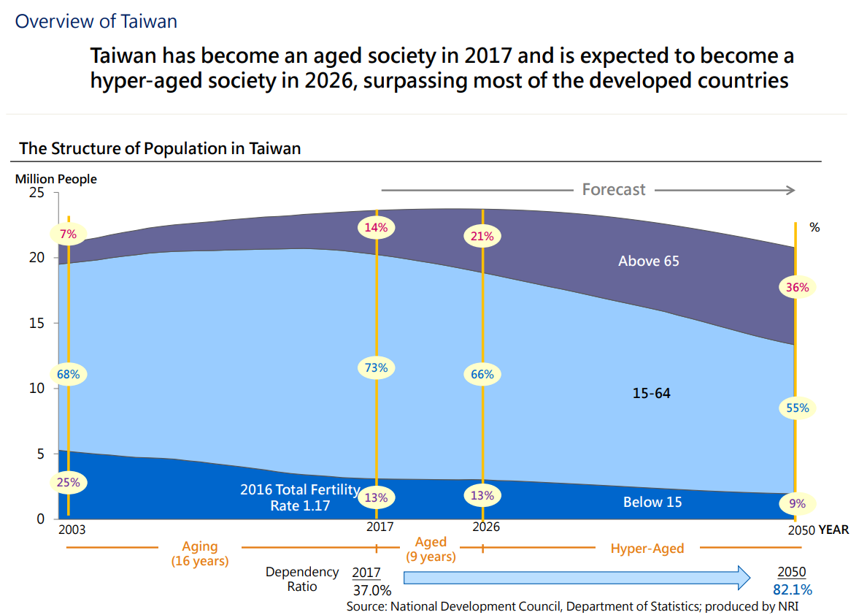

Slide 3
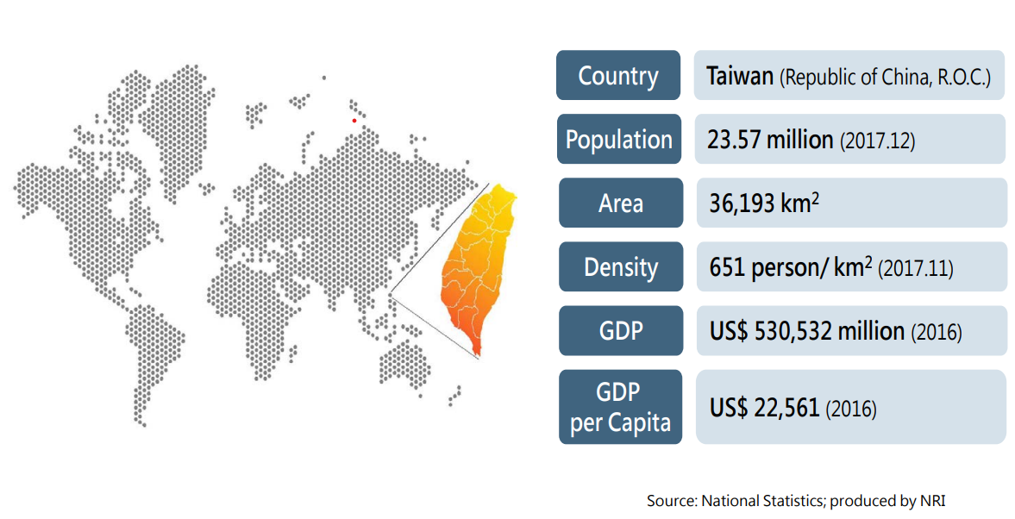

Slide 4
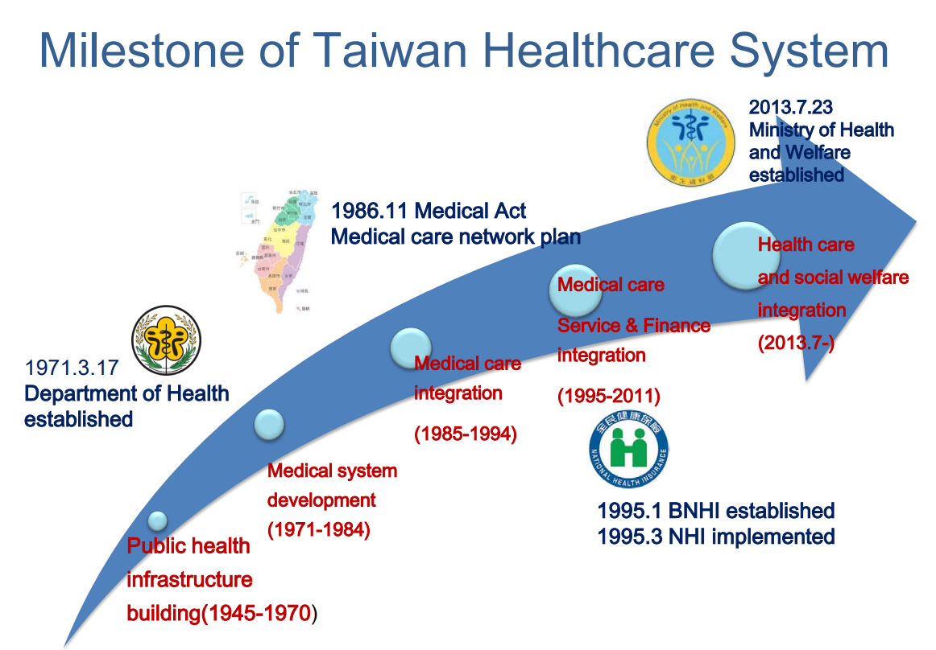

Slide 5
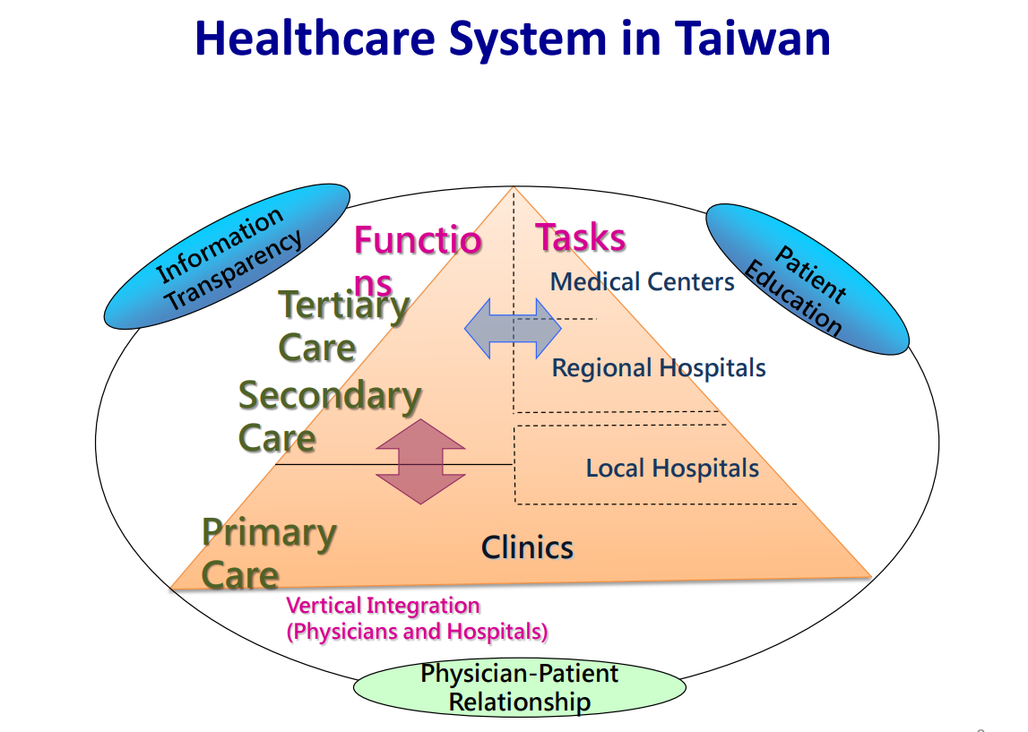

Slide 6
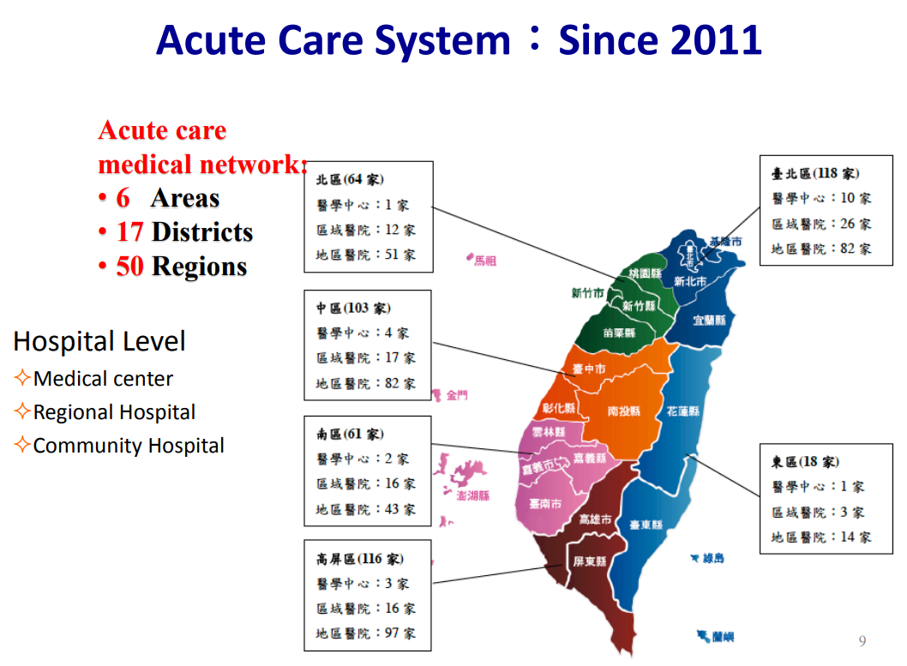

Slide 7
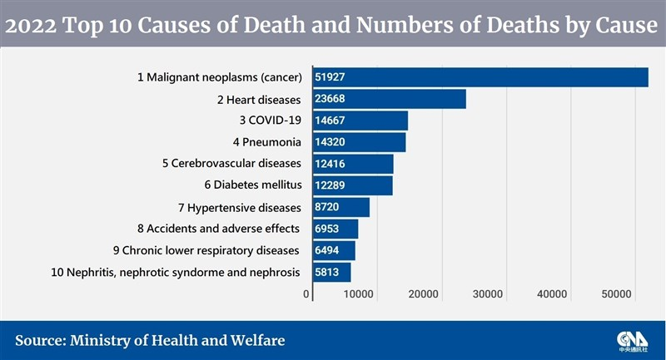

Slide 8
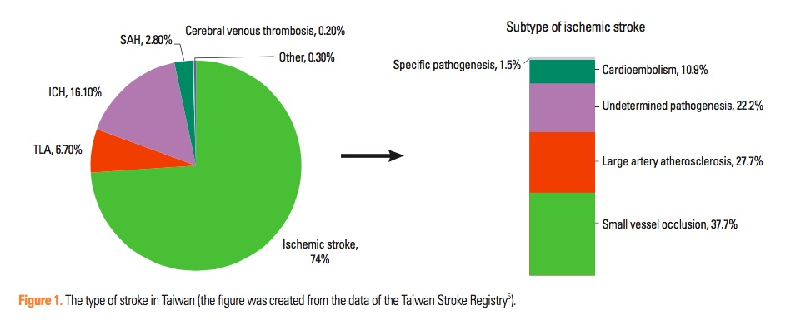
Journal of Stroke 2014;16(2):59-64

Slide 9
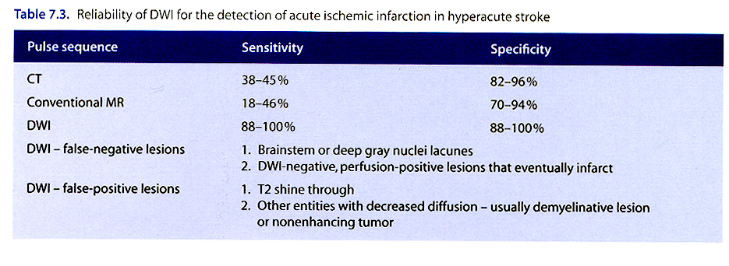
電腦斷層(CT)、傳統磁核共振(MRI)、擴散磁振造影共振(DWI)之比較

Slide 10
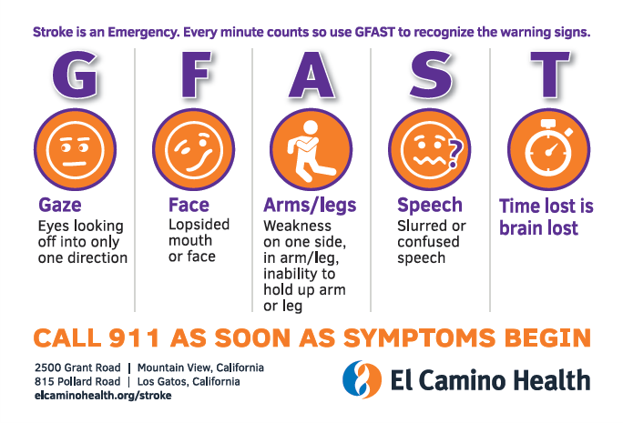

Slide 11
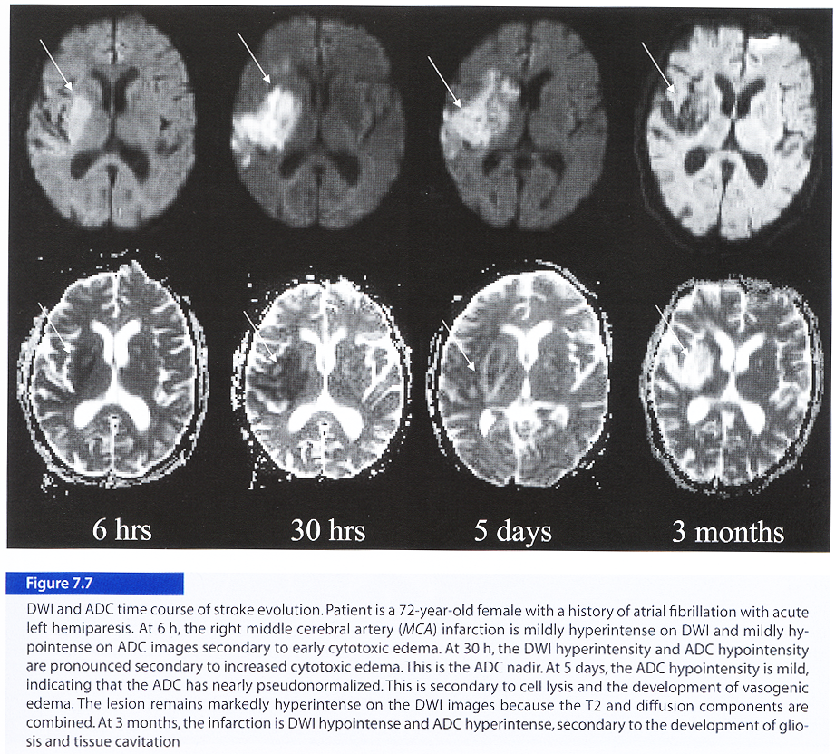
DWI
ADC

Slide 12
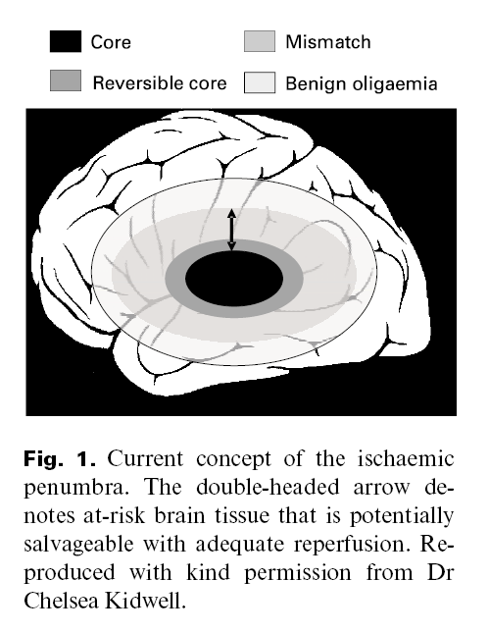
Penumbra
Time is Brain !
Intra-venous tPA:
4.5 hrs
Endovascular EVT therapy: 8 - 24 hrs

Slide 13
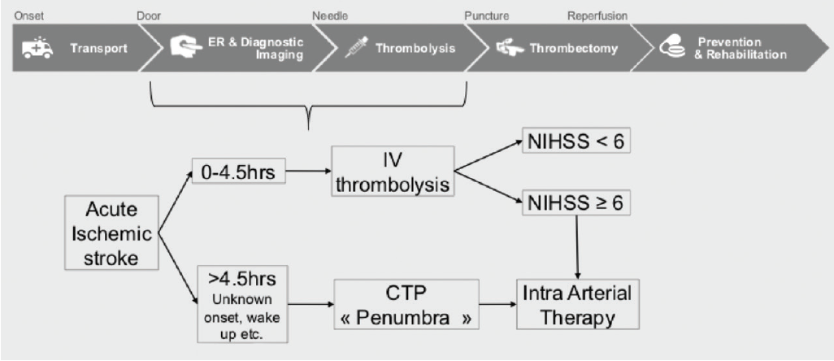
Endovascular Today, FEBRUARY 2018

Slide 14
DEFUSE III ＆ DAWN clinical trial

Slide 15
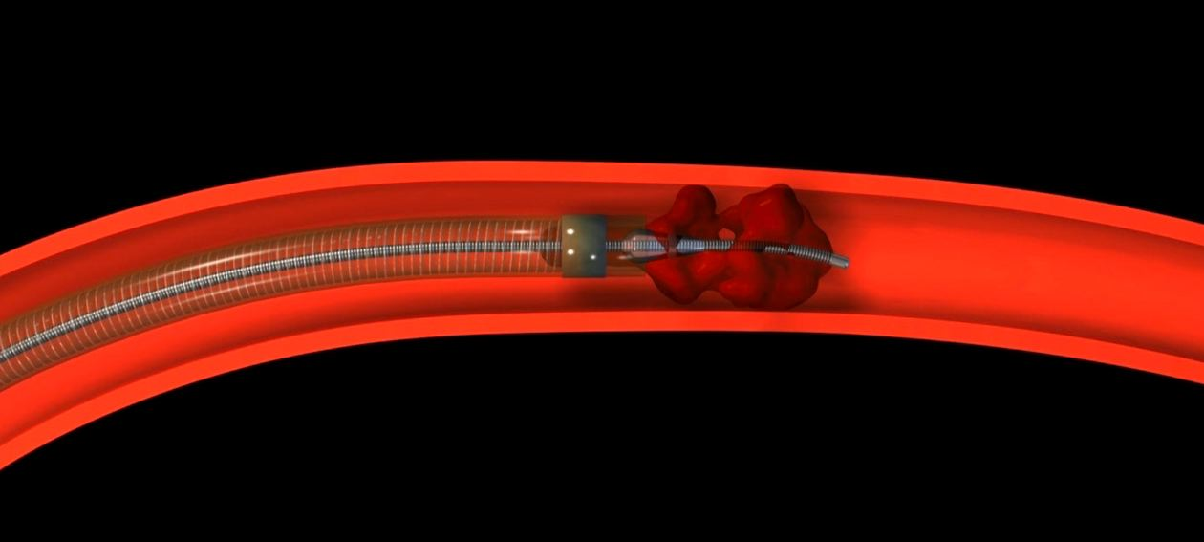
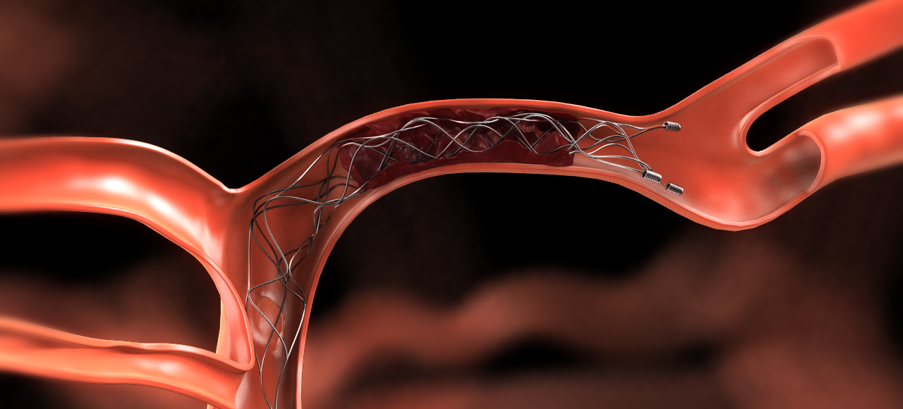
EVT器械
進行EVT時，抽吸式血栓移除及多重裝置 亦為合理的替代選擇(Class IIa，Level of Evidence B-R)。
進行EVT時，支架式血栓移除為首選建議 (Class I，Level of Evidence A)。

Slide 16
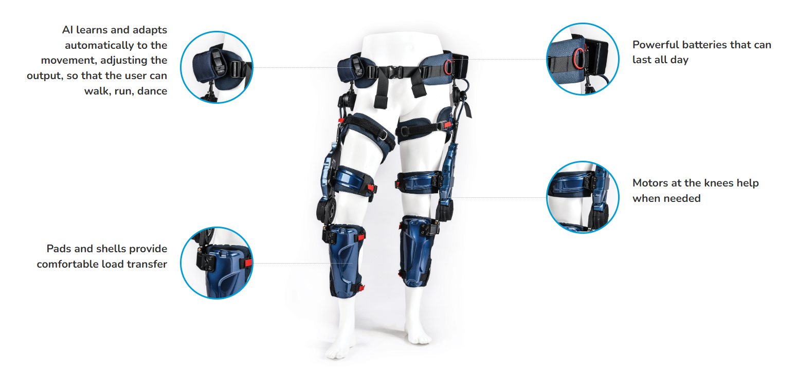
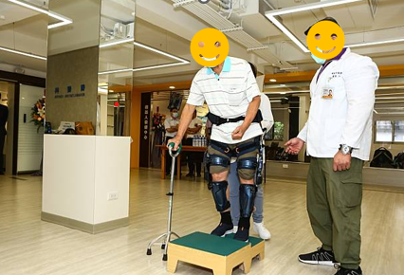
Wistron Exoskeleton
KEEOGO

Slide 17
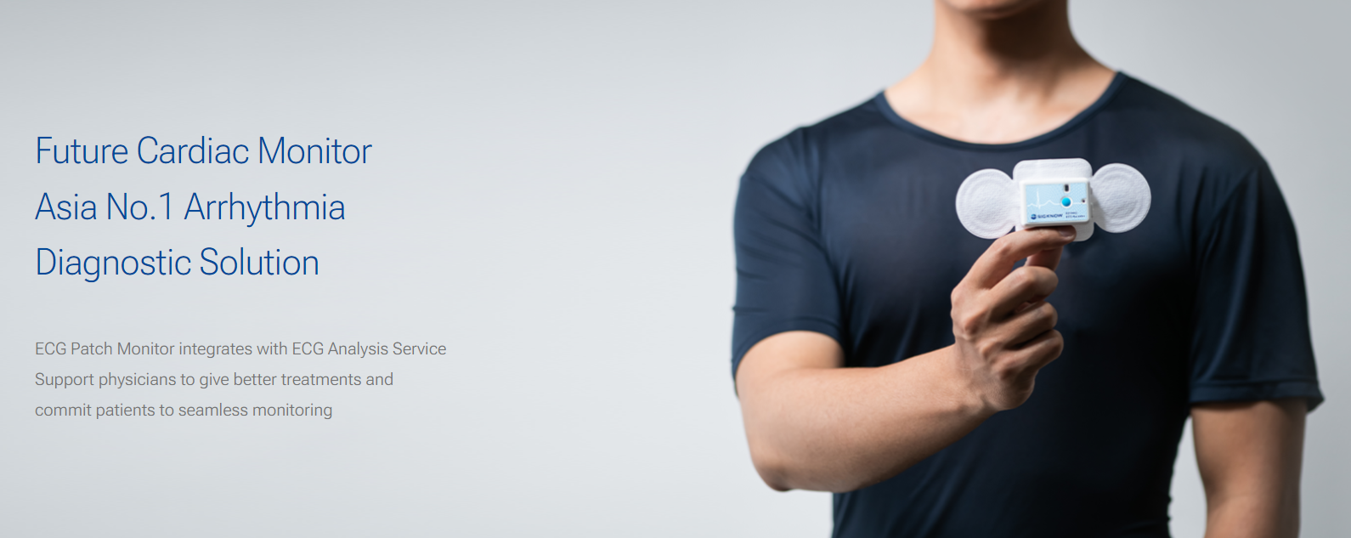
EZPRO Clinical Trial for Embolic stroke of undetermined source (ESUS) detection

Slide 18


Thank You for Listening

